Slide 1
Vision Transformers, Ensemble Model, and Transfer Learning Leveraging Explainable AI for Brain Tumor Detection and Classification
IEEE Journal of Biomedical and Health Informatics
Date of Publication: 12 April 2023
Reporter Name : 宋海泊

Slide 2
目录/Contents
01
Introduction
02
Methodology
03
Experimental Results

Slide 3
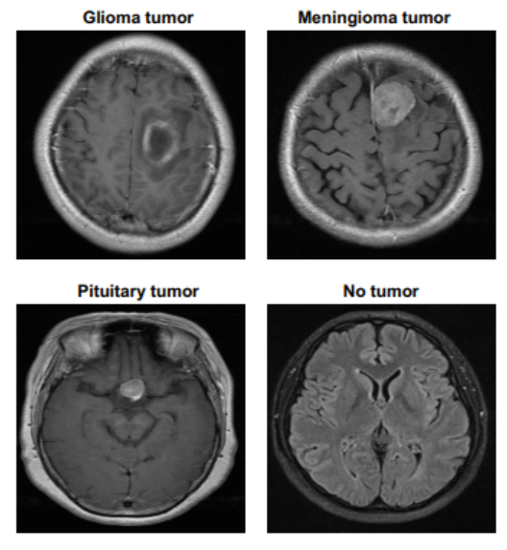
Introduction
The abnormal growth of malignant or nonmalignant tissues in the brain causes long-term damage to the brain.
Magnetic resonance imaging (MRI) is one of the most common methods of detecting brain tumors.
Although MRI scans can be used manually to identify brain tumors, this is a static procedure that produces inaccurate results.
DL algorithms can be used in these scenarios since
they can replace manual methods that are time-consuming,

Slide 4
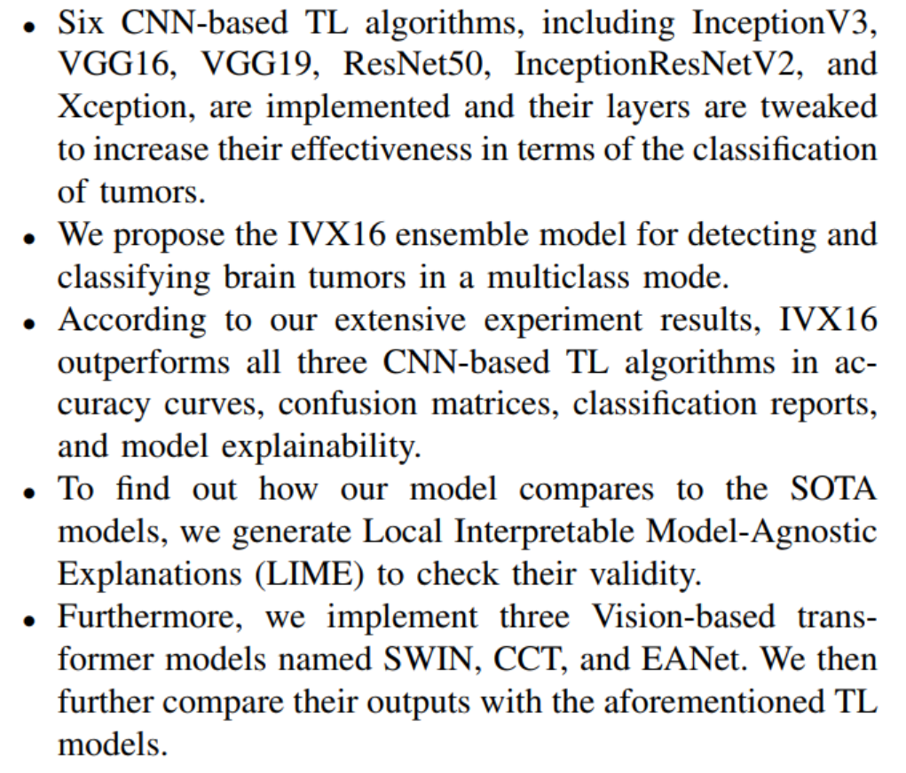
Major Contributions

Slide 5
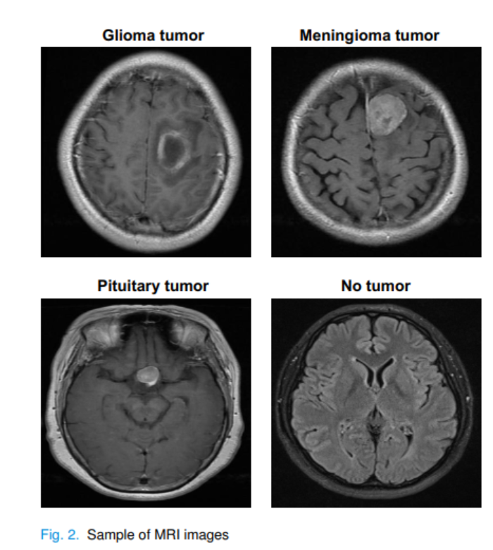
Methodology
Dataset
They use a multiclass brain tumor dataset containing four classes of data including, Pituitary tumors, Glioma tumors, Meningioma tumors, and no tumors. Dataset contains 3264 images [41]. The dataset was partitioned into sets for training, testing, and validation, each with 80%, 10%, and 10% of data. With the ImageDataGenerator function, they virtually augmented the dataset by rescaling, shear range, zoom range, and horizontal flipping and increased the dataset four times from 3264 to 13056.

Slide 6
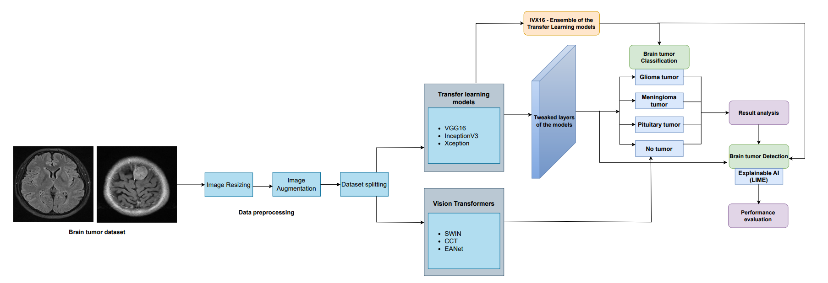
Methodology
They fed data to six TL models with layers tweaked to increase their efficacy, the ensemble of the three best models (IVX16), and three ViT-based models. IVX16 models using LIME, an Explainable AI tool.

Slide 7
Model Development
Basic Deep Learning Classifiers
Six models: InceptionV3, VGG16, VGG19, ResNet50, InceptionResNetV2, and Xception.
Vit Models
Three Vision-based transformer models named SWIN, CCT, and EANet.
On small datasets such as the one used in this paper, ViT fails to produce the same remarkable results
as it does on large ones.
Proposed Hybrid Model
For better results, they build an ensemble model based on the above models. Their ensemble model,
named IVX16, aggregates predictions from VGG16, InceptionV3, and Xception.

Slide 8
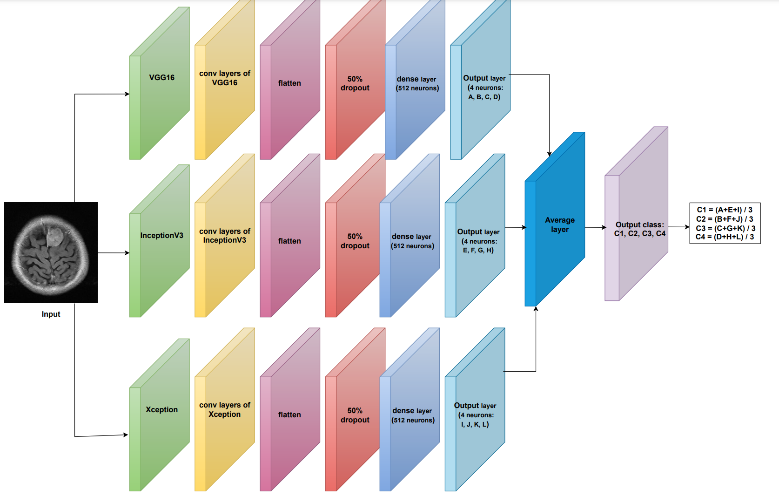
Proposed Hybrid IVX16 Model
Ensemble models can shed light on which features or models are crucial for making predictions for
interpretability or feature selection.

Slide 9
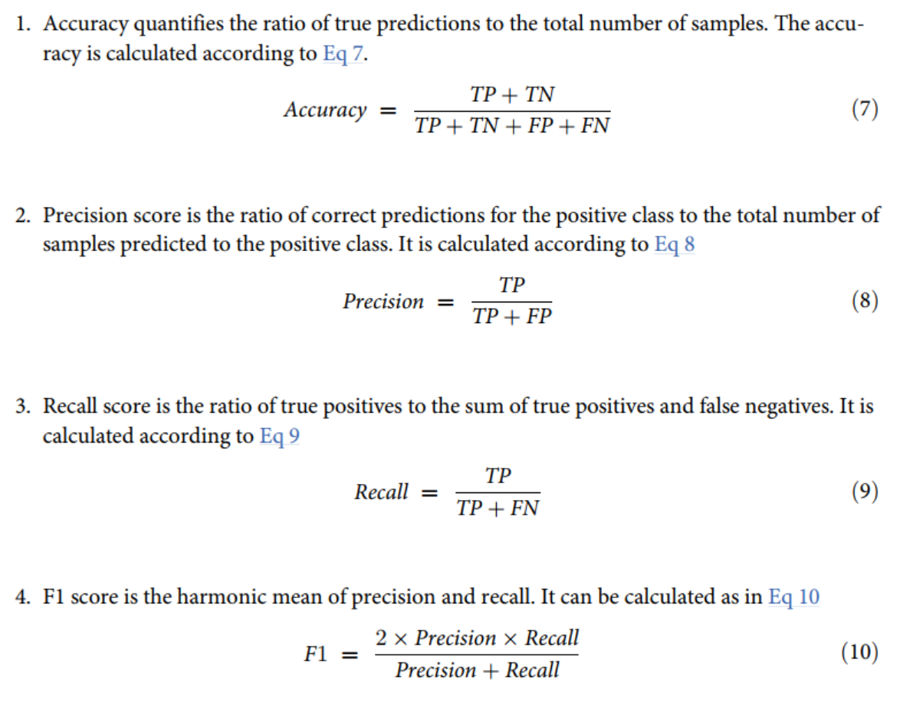
Model Evaluation Protocols

Slide 10
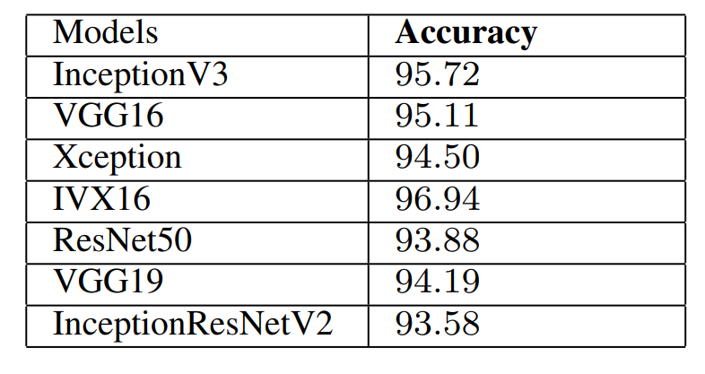
Experimental Results
Ensemble model and comparison model results.
IVX16 produces a peak accuracy of 96.94%.

Slide 11
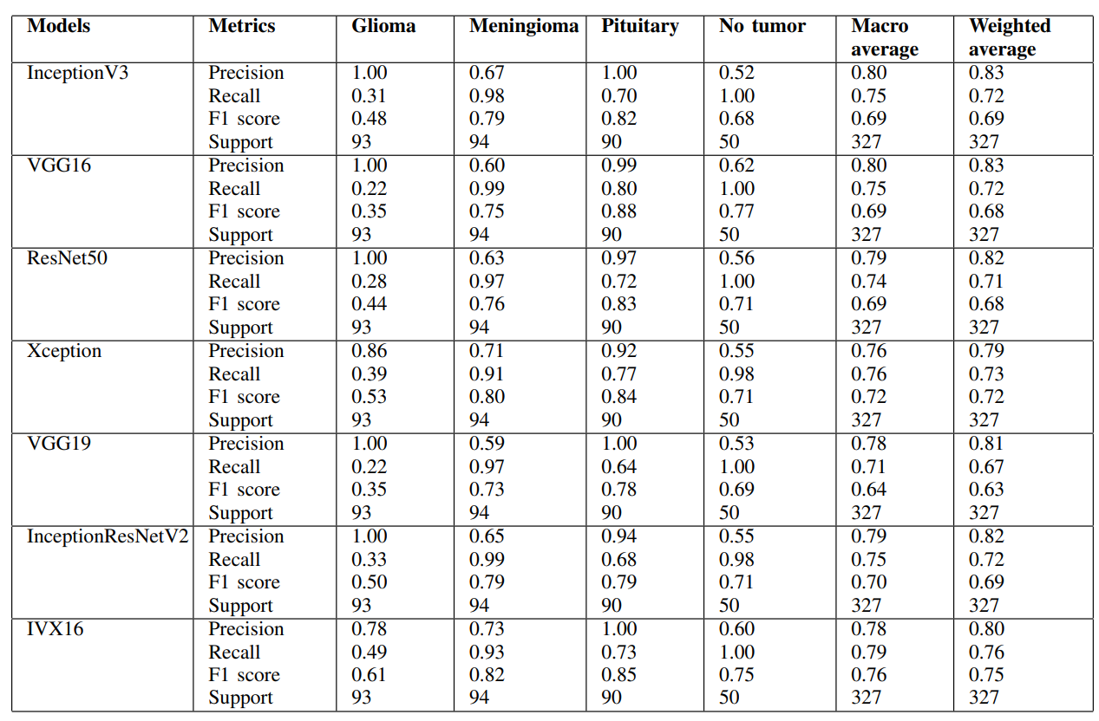
Experimental Results

Slide 12
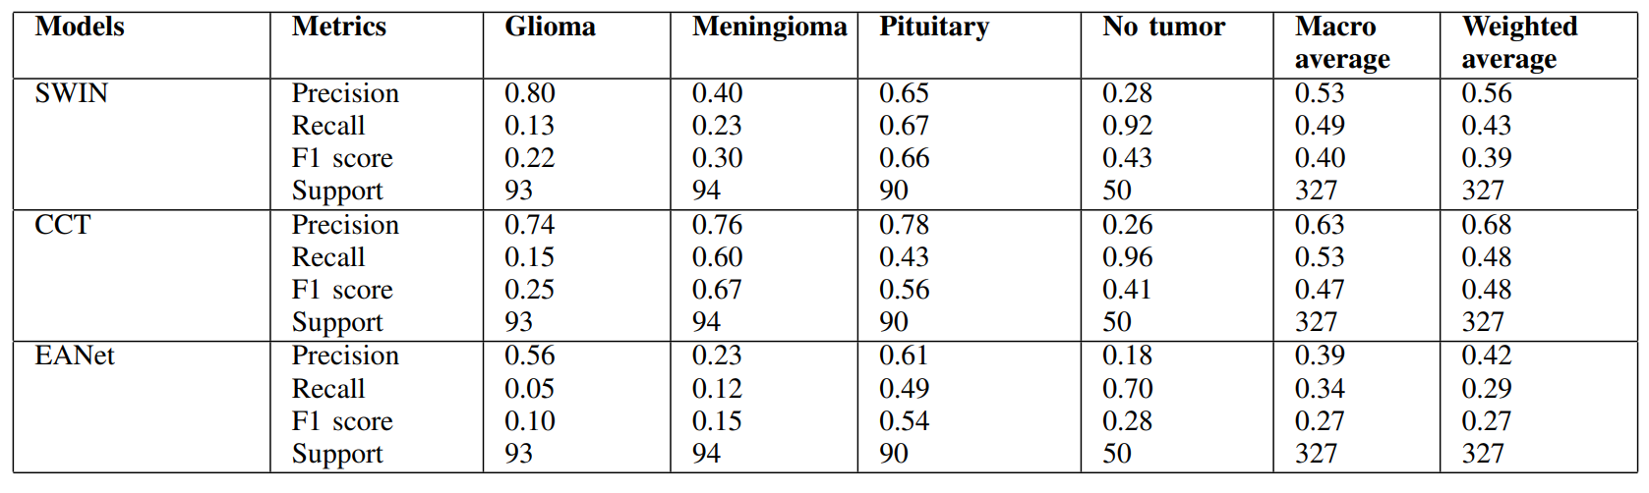
Experimental Results
CLASSIFICATION REPORT FOR VIT MODELS
In the classification report of the ViT models, once again see poor values across all the classification metrics for each of the models.
The highest value observed is 0.80 which is the precision value for the SWIN transformer on the Glioma tumor.

Slide 13
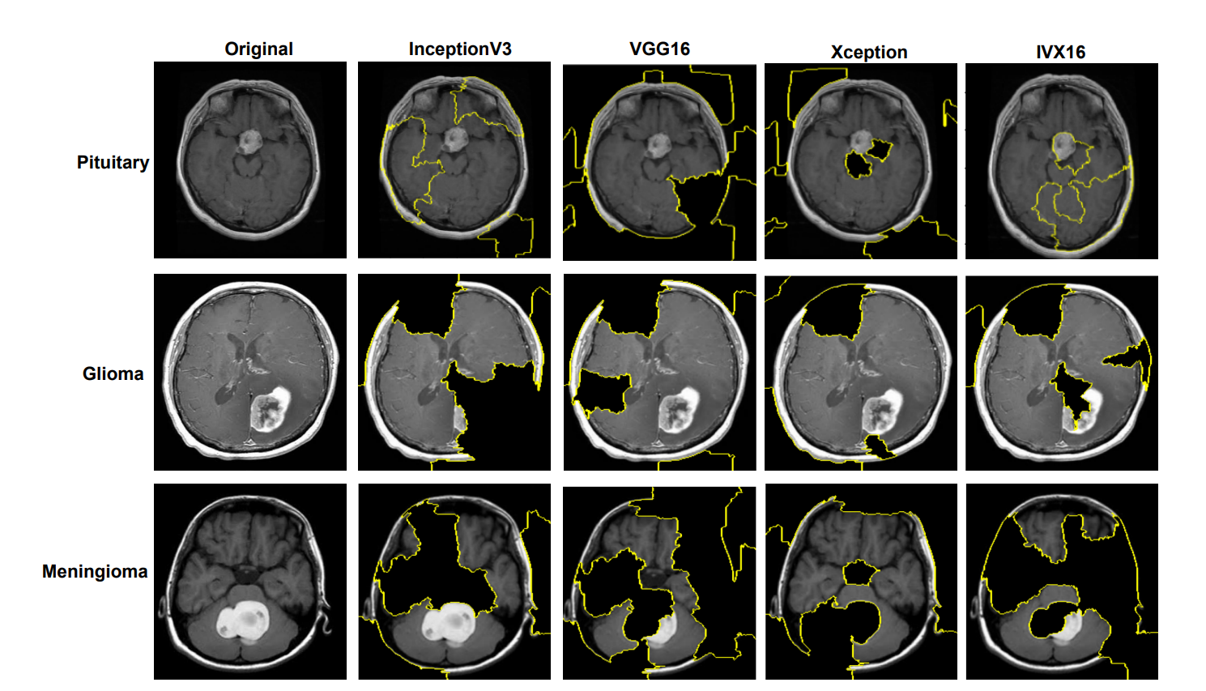
TL and Ensemble Model Explainability by LIME
The ensemble model IVX16 produces three different green patches, out of which one completely encloses the tumorous region, making IVX16 the best classifier.

Slide 14
My Views on the Paper's Research Findings and Limitations
Low results for brain tumor detection
Lack of exploration of advanced ensemble or hybrid learning:
The study does not investigate the potential benefits of advanced ensemble learning techniques.
They simply combine three models using the average layer.
Absence of optimization algorithms such as nature-inspired:
The paper does not incorporate optimization algorithms which could potentially improve the training process and model convergence.

Slide 15
Thanks for Listening

